Slide 1
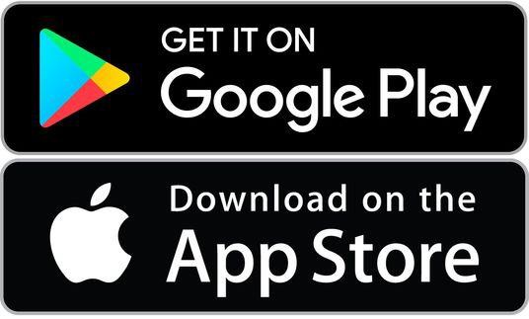
ParentView
Self-Guided Tools
Registering to track your route GPS District Code
Step 1:
Download app¹, Register/Confirm your account, & Log-In²
Step 1
You can also access the app at web.firstviewapp.com
Users must enter their First Name, Last Name, Phone Number, Email Address, State, School District, and Choose a Password. By registering for and using a FirstView account, you also consent to our terms of use and our privacy policy.

Slide 2
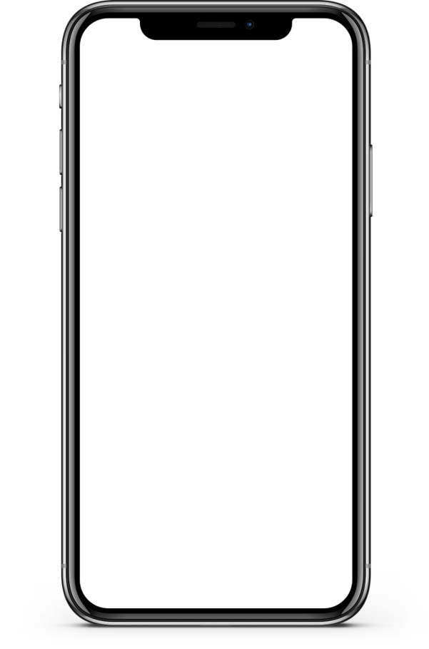
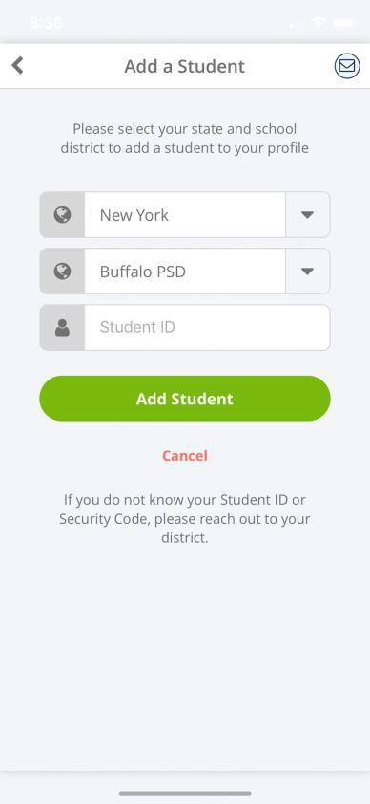
ParentView
Self-Guided Tools
Registering to track your route
Step 2: Register
Select your state and school district from the drop down
Add your district code
State
School District
District Code
*If you do not know the code(s) required to add your student, please contact your school district.

Slide 3
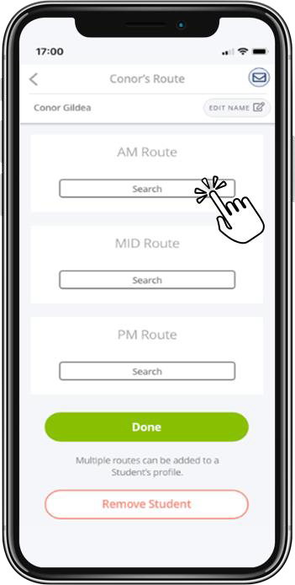
ParentView
Self-Guided Tools
Registering to track your route
Step 3: Search AM, MID, and PM Routes to track
Search for your student’s assigned
Route(s)*
You will need to set-up tracking for your morning route, midday, and afternoon route separately
Step 1
*If you do not know your student’s assigned route, please contact your local First Student Office or your district

Slide 4
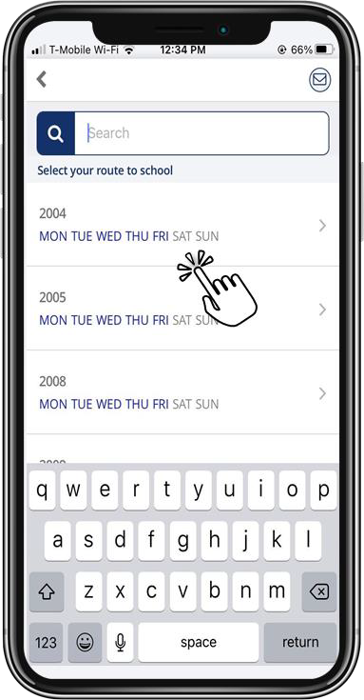
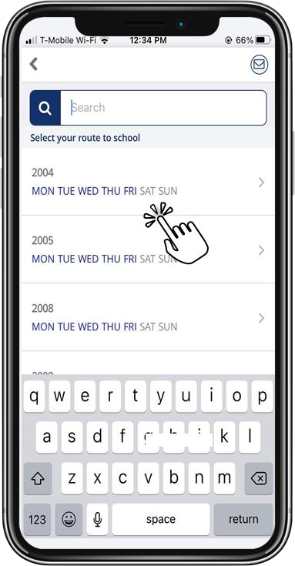
ParentView
Self-Guided Tools
Registering to track your route
Step 4: Add Route
Search and select for your student’s
assigned route by typing in the name/number or scrolling
You can see days of the week the
route operates in blue
Step 1
*If you do not know your student’s assigned route, please contact your local First Student Office or your district

Slide 5
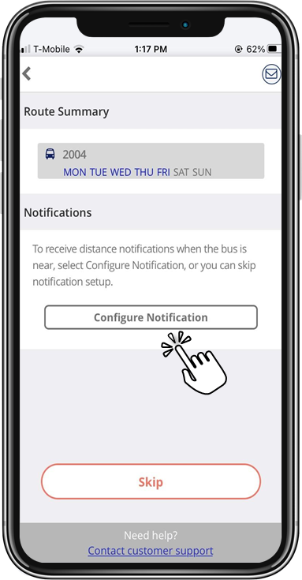
ParentView
Self-Guided Tools
Registering to track your route
Step 5: Configure Notification
Select configure notification to receive an alert when the bus is near your student’s stop location
Skip if you don’t want to add a stop location for notifications and just want to track the bus on the map
Step 1

Slide 6
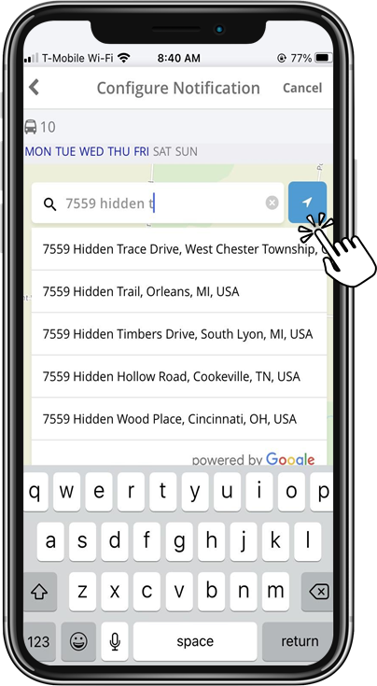
ParentView
Self-Guided Tools
Registering to track your route
Step 6: Add Your Stop Location
Enter and select the address where your student gets on and off the bus
Or use location services to drop a pin
on the map at your current location
Step 1

Slide 7
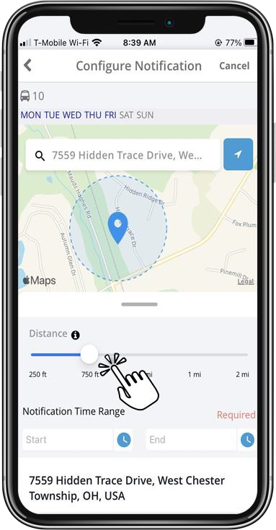
ParentView
Self-Guided Tools
Registering to track your route
Step 7: Add Distance Range
Use the distance slider to define a radius (geofence) around your stop. When the bus crosses into that radius, you’ll get a notification the bus is near
Step 1

Slide 8
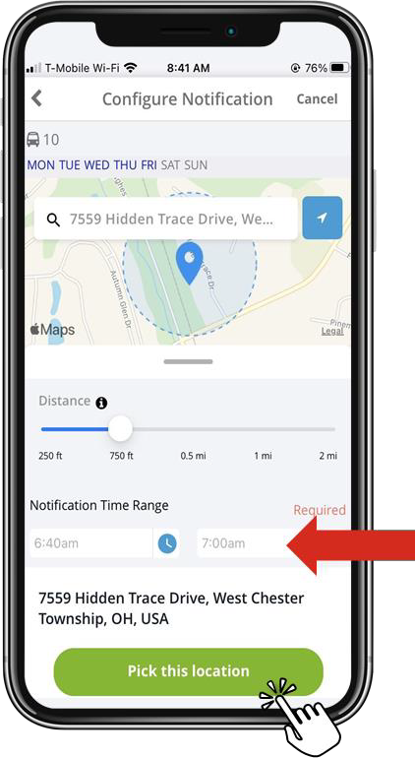
ParentView
Self-Guided Tools
Registering to track your route
Step 8: Add Time Range
Enter your notification time range, so you’re only notified if the bus enters this area around this time
We recommend no more than 30 minutes before or after your scheduled stop time
When done, select “Pick this location”
Step 1

Slide 9
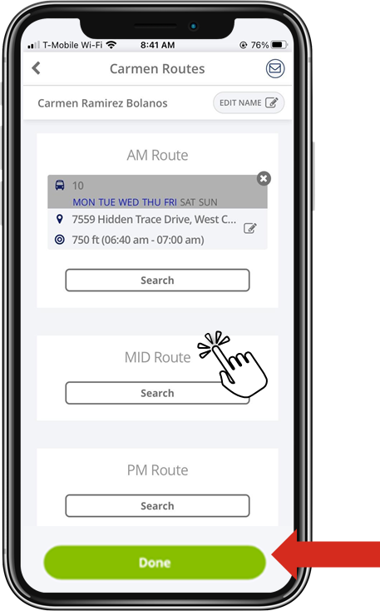
ParentView
Self-Guided Tools
Registering to track your route
Step 9: Add Additional Routes
Complete the previous steps to add all of your student’s routes for tracking and select Done*
Step 1
*You can also update your notification by selecting the edit icon and/or delete the route and notification completely by selecting the X

Slide 10
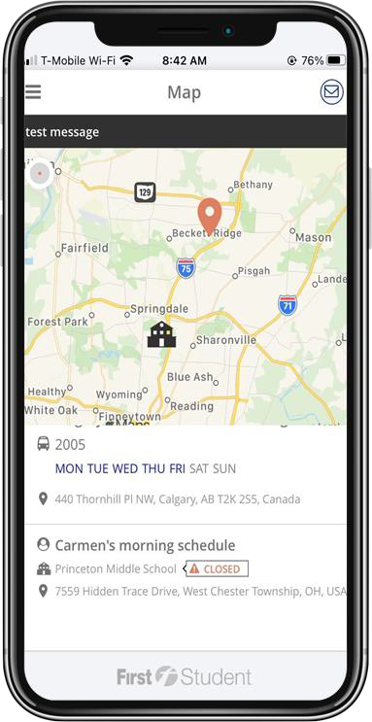
ParentView
Self-Guided Tools
Registering to track your route
Happy Tracking!
See the bus location on the map in near real-time and get your distance notifications in the app, via push notification, or by e-mail
Contact Support using the envelope button in the app
Step 1
*You can add and edit notifications, add new students to track, and add additional routes to follow in your Profile

